Slide 1
Report
Sep-2023 MP Inspection BFX – UA300
Date : 13-Dec-2023
Prepared by: Rachel Ruan

Slide 2
Issue Description
12-Oct, ALT customer complain [BFX-UA300] Sep – 2023 Mass production issue.
Overall inspection result => Conditional Pass (Waived)
Defect Total:
Critical
• Issue not inserting into USB 2.0 port * 1pcs
• Minor
• RJ 45 Cable function NG *1psc

Slide 3
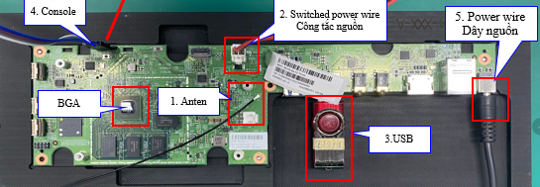
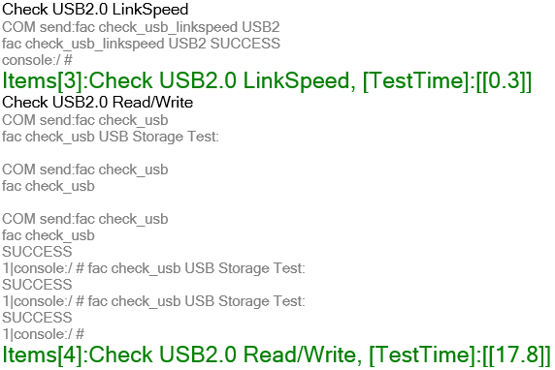
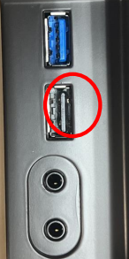
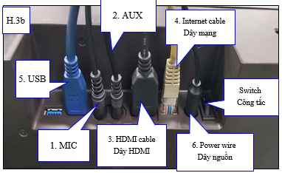
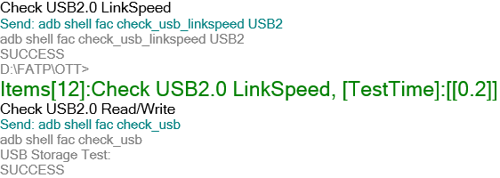
1. Issue not inserting into USB 2.0 port
Issue Description | Root cause | Conclusion | Status
Symptom: Issue not inserting into USB 2.0 port Type: Critical Defect unit Q’ty : 1/200pcs Defect rate : 0.5% SKB SN: 2149695001202303011195 | 1. Customer check visual check : damaged pin on USB 2.0 port and customer can not inserting into USB 2.0 port . 2. Fii Check FATP data Product test FATP pass normally. Recheck log test on BT and FT1 station: ➔ Check log test, Result: PASS | AS check this SN : 2149695001202303011195 All FATP is normal process. No any repair or dis-assembly housing recode. 04/Dec/2023, Fii received NG sample from ALT. We analysis on the next page.

Slide 4
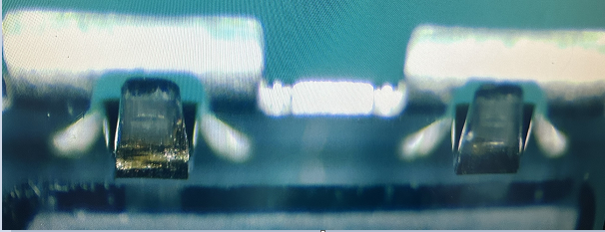
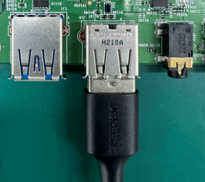
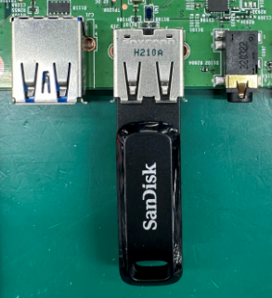
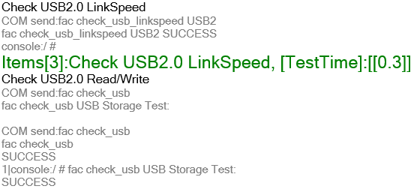
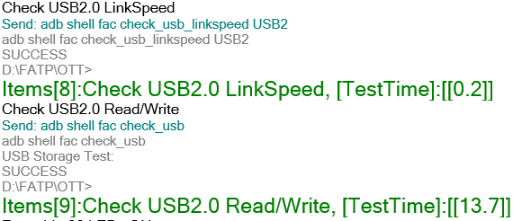
1. Re-test NG sample customer return result USB 2.0 port
FA | Actions | Status
1. Fii received and inspected USB 2.0 port of NG sample ➔Found USB 2.0 has scratch at lock. 2. We insert USB 2.0 port by hand 50 times => Result is OK, No abnormal issue. 3. We Re-Assembly to K18X001.00 product and Check FATP data Retest NG sample on BT and FT1 station. ➔ Product test FATP pass normally. | Conclusion : 1. Visual defect but function USB 2.0 check OK. Re-command update SOP visual inspection focus all port after function test . Status: Done. 2. We will monitor this issue online for the next build.
BT station
FT1 station

Slide 5
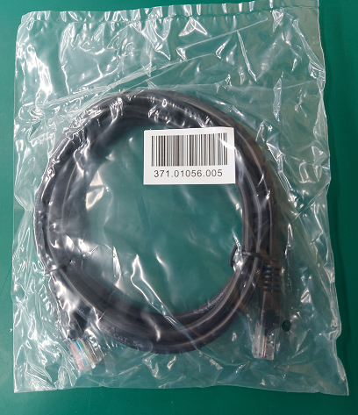
2. RJ 45 cable high speed not supported * 1pcs
Issue Description | Root Cause | Action | Status
Symptom: RJ 45 Cable function NG *1psc Type: Minor Defect unit Q’ty : 1/200pcs Defect rate : 0.5% | Check RJ45 data : 371.01056.005 - DC20230817 ( 20K ). Vendor FIT 2. RJ45 is accessory material. Online no any function test. On IQC station - IQC test connecter testing follow AQL: 10 ( Function test ). 3. Vendor FIT confirm function connecter test 100% on process. | 1. Feedback vendor for re-check all material on stock. Done 15-Oct-2023. 2. Fii waiting NG sample for more analysis find out root cause and corrective action.

